Slide 1
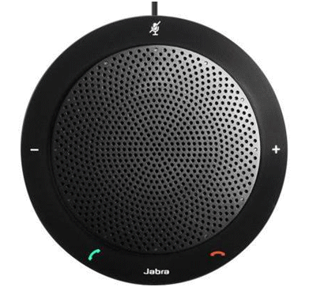
Splunk Fundamentals: Level 1
Instructor: Dan Costello Email: danc@onlc.com
Class begins at 10 Eastern time
For Class Audio Connection:
ONLC Office Locations – Audio is connected over Jabra™ speaker
Home or Office – Call: ____ Access Code: ___ # Enter the audio pin shown in the GoToMeeting panel
If you need assistance, call 800-288-8221

Slide 2
Splunk Fundamentals: Level 1

Slide 3
Student introductions
Your name
Company affiliation
Title/function
Splunk experience
Your expectations for the course
Notes:
Ask students to introduce themselves and provide their backgrounds, product experience, and expectations for the course.
Record student expectations on a whiteboard or flip chart that you can reference during class.

Slide 4


Housekeeping
Class hours: 10:00-16:45
A.M./P.M. Breaks: 15 min.
Lunch Break: 1 hr.
ONLC Wifi access code (if present): 0123456789
If you need anything, please let us know!
Notes:
Explain class and facility logistics, using the bulleted list. Inform students about any emergency procedures, such as emergency exits, and plans in the event of fire or other emergencies.

Slide 5

The Courseware
Splunk 7 Essentials
Supplemental notes: http://bit.ly/ONLCXSPLK1

Slide 6
Classroom Setup
Windows 10
Course Files

Slide 7
Course Outline
Splunk - Getting Started
Installing Splunk
Creating a Splunk App
Populating data with Eventgen
Controlling Splunk
Viewing the Destinations app
Creating your first dashboard
Bringing in Data
Splunk and big data
Splunk data sources
Creating Indexes
Buckets
Log Files as data input
Splunk events and fields
Extracting new fields
Search Processing Language
Anatomy of a search
Time modifiers
Filtering search results
Additional Search commands
Reporting, Alerts, and Search Optimization
Data classification with Event Types
Data normalization with Tags
Data enrichment with Lookups
Creating and scheduling reports
Creating alerts
Search and Report acceleration
Scheduling options
Summary indexing
Dynamic Dashboarding
Creating effective dashboards
Types of dashboards
Form inputs
Creating a time range input
Static real-time dashboard
Creating a choropleth map
Data Models and Pivots
Creating a data model
Data model acceleration
Rearranging your dashboard

Slide 8

Related Classes
Splunk Fundamentals – Level 2

Slide 9
Questions?

Slide 10
Module 1: Getting Started

Slide 11
Module 1: Getting Started
Installing Splunk
Creating a Splunk App
Generating test data
Controlling Splunk

Slide 12
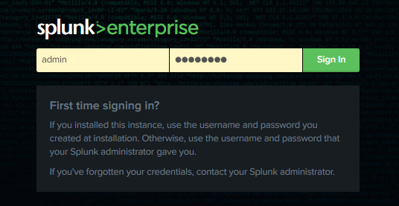
Splunk - Getting Started

Slide 13
A brief history of Splunk
Founded in 2003 by Michael Baum, Rob Das, and Eric Swan
Original product designed to ease and streamline log analysis (Operational Intelligence)
Now moving more generally into data analytics (Business Intelligence)
Name comes from Spelunking, i.e., cave exploring, which the founders felt was an apt analogy

Slide 14
Security Information and Event Management (SIEM)
Real-time (or close to it) analysis of security event data
Often includes alerting & automated responses
Very common application for Splunk
One of the top “leaders” in Gartner’s 2020 SIEM Magic Quadrant report
Competitors include IBM QRadar, Exabeam, Securonix

Slide 15
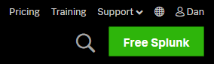
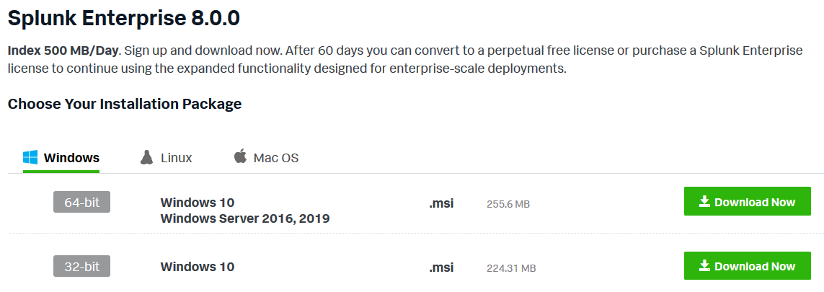
Installing Splunk
Create Splunk account
Select license
Download installer

Slide 16

Installing Splunk
Interactive: Launch installer, follow prompts (For reference, see https://docs.splunk.com/Documentation/Splunk/8.0.0/Installation/InstallonWindows)
Unattended: Refer to command line switches at https://docs.splunk.com/Documentation/Splunk/8.0.0/Installation/InstallonWindowsviathecommandline

Slide 17
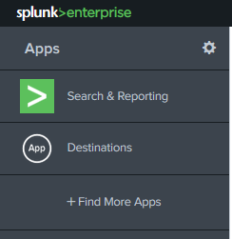
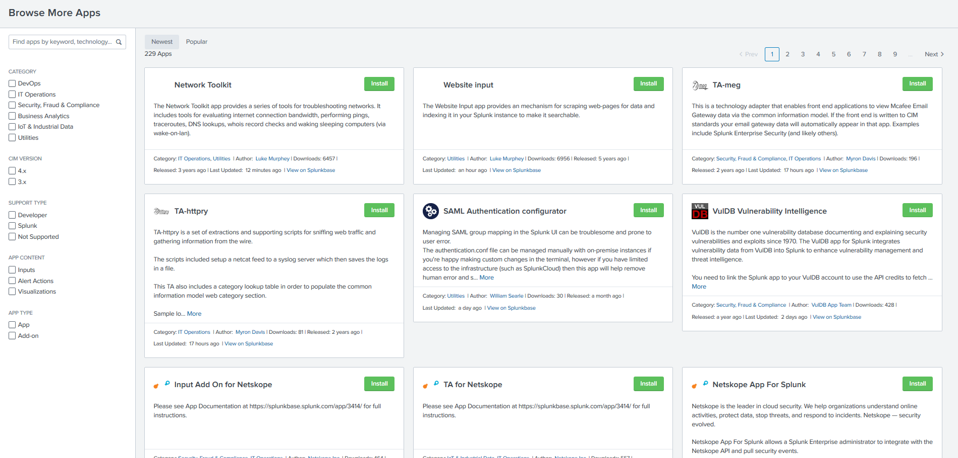
Splunk Apps
App: An application that runs on the Splunk platform
Container for customized functionality

Slide 18
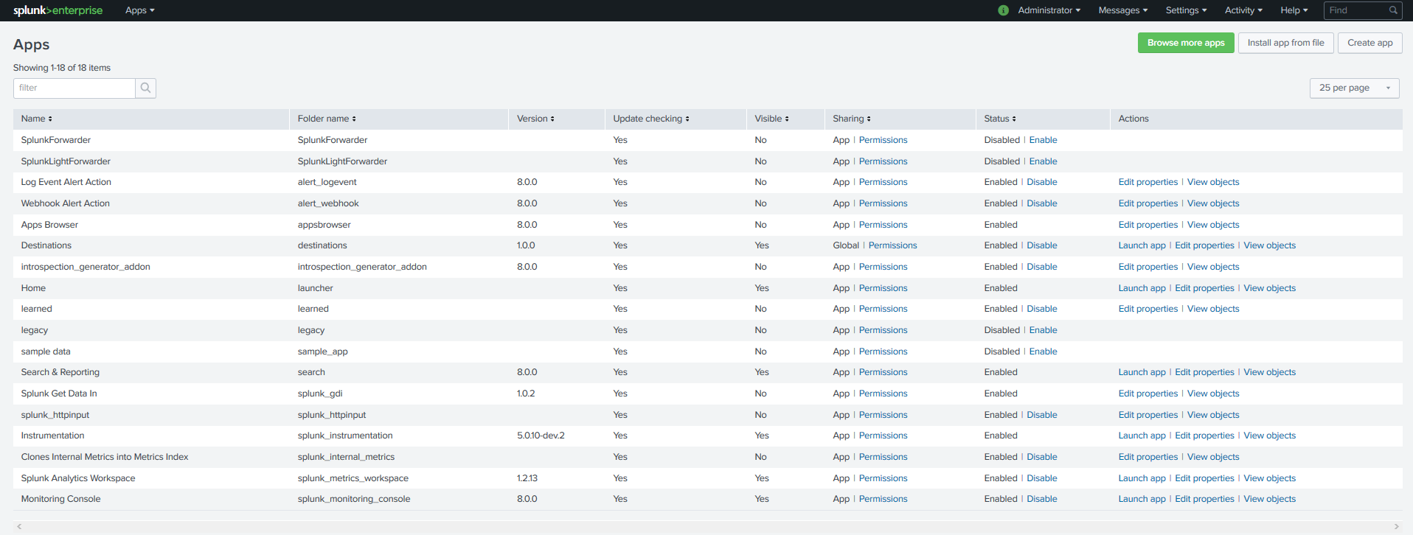
Creating a Splunk App
Go to Manage Apps → Create app
Specify name, directory, version, author, template, etc.
Creates a directory structure for your customizations
See: https://dev.splunk.com/enterprise/docs/developapps/createapps/createsplunkapp/

Slide 19
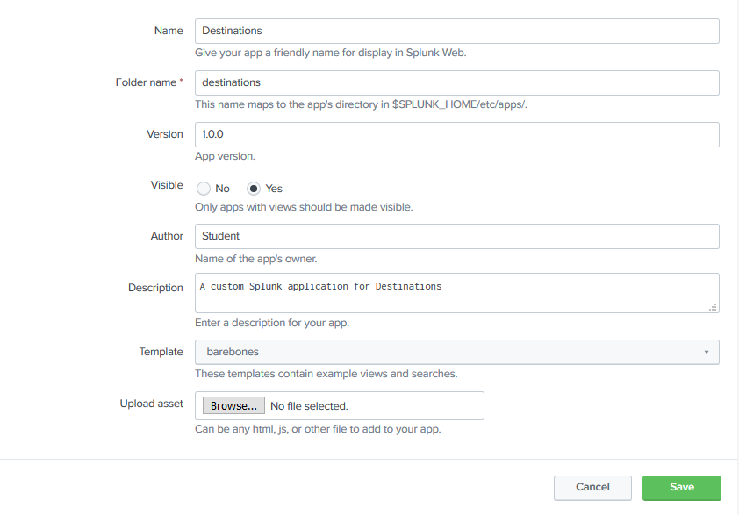
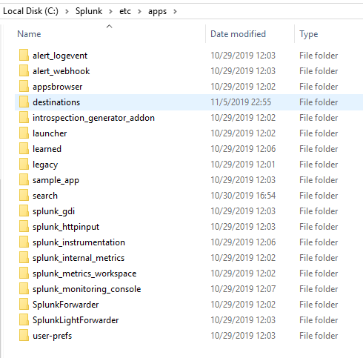
Creating a Splunk App

Slide 20
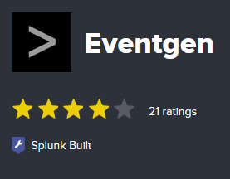
Populating data with Eventgen
“The Splunk Event Generator (Eventgen) is a utility which allows its users to easily build real-time event generators. Eventgen allows an app developer to get events into Splunk to test their applications. It provides a somewhat ridiculous amount of configurability to allow users to simulate real data.”

Slide 21
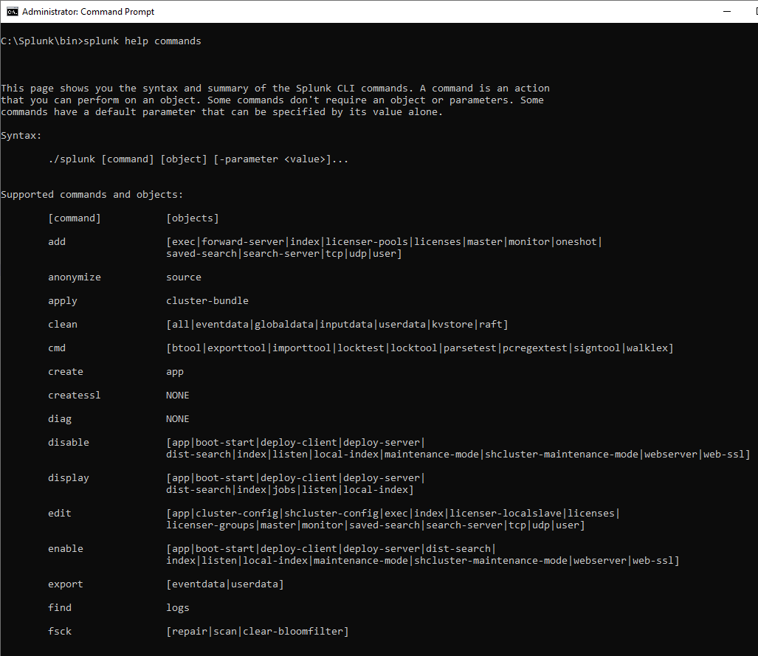
Controlling Splunk
$SPLUNK_HOME\bin\Splunk
Start
Stop
Restart
Help commands
etc.

Slide 22
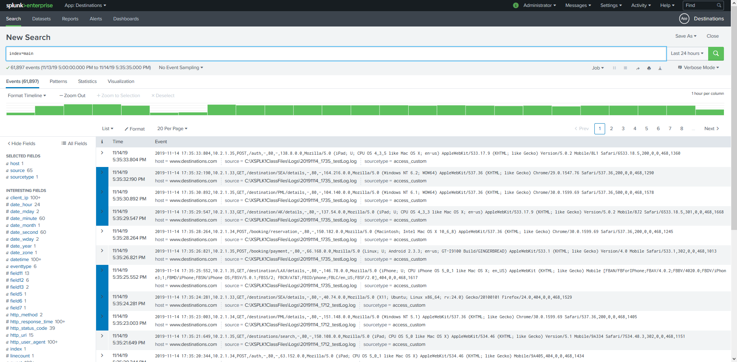
Viewing the Destinations app
Splunk app you will create for this class
Uses a simulated web server log for a fictional travel company

Slide 23
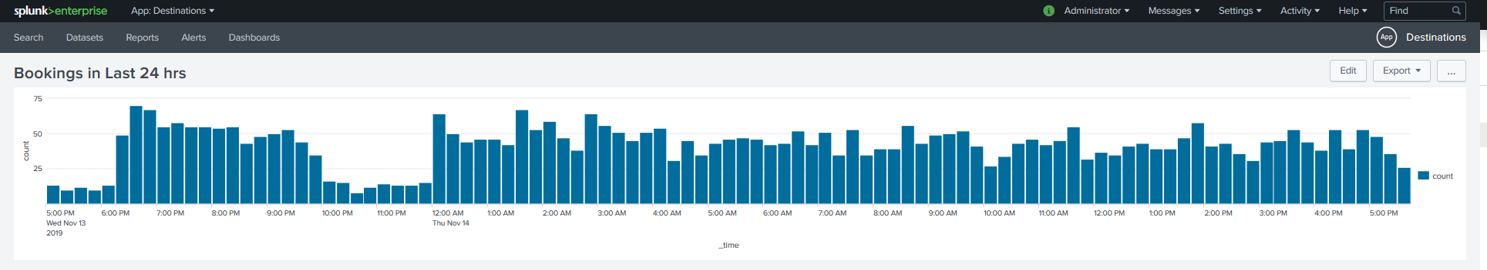
Creating your first dashboard
After creating the initial app, you will create a simple dashboard to visualize some data

Slide 24

Lab 1: Getting Started
Estimated Duration: 45 minutes
Obtaining a Splunk Account, Page 8
!! NOTE: There is no need to perform the download in step 6, as the Splunk installer is already on your lab machine at C:\XSPLK1ClassFiles\SplunkInstaller\
Logging in for the First Time, Page 13
Installing Splunk on Windows
!! NOTE: Please see the alternate instructions in this notebook on Installing Splunk 8.0
Running a Simple Search, Pages 14-15
Creating a Splunk App, Pages 16-18
Populating Data with Eventgen
!! NOTE: As of this writing, Eventgen does not work correctly with Splunk 8.0. Therefore, we have provided an alternate mechanism for generating sample data that will function with the book exercises. To set it up, please follow the alternate instructions in this notebook on Setting Up Demo Data Collection
Controlling Splunk, Pages 22-24
!! NOTE: The next section of the book refers to configuring Eventgen. Please skip this section.
Viewing the Destinations App, Pages 26-28
Creating Your First Dashboard, Pages 28-31
Questions? Comments?
Dan’s cell phone: (413) 455-0856
Dan’s email: danc@onlc.com

Slide 25
Module 2: Bringing in Data

Slide 26
Bringing in Data
Splunk was originally developed to parse machine logs, receive machine data streams, e.g., syslog
Has expanded to consume & analyze other types of data, e.g., databases, spreadsheets, RESTful web services

Slide 27
Splunk and big data
In this context, “Big Data” refers to “large volumes of unstructured or semistructured data that needs to be explored”
Splunk is designed to easily and flexibly explore data of almost any type

Slide 28
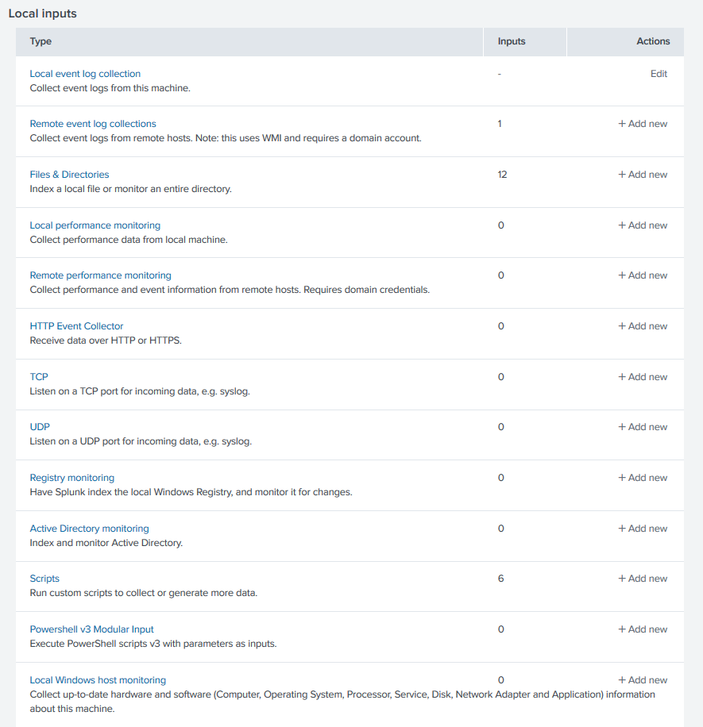
Splunk data sources
Files
Databases
Web services
Scripts
etc.

Slide 29
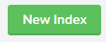
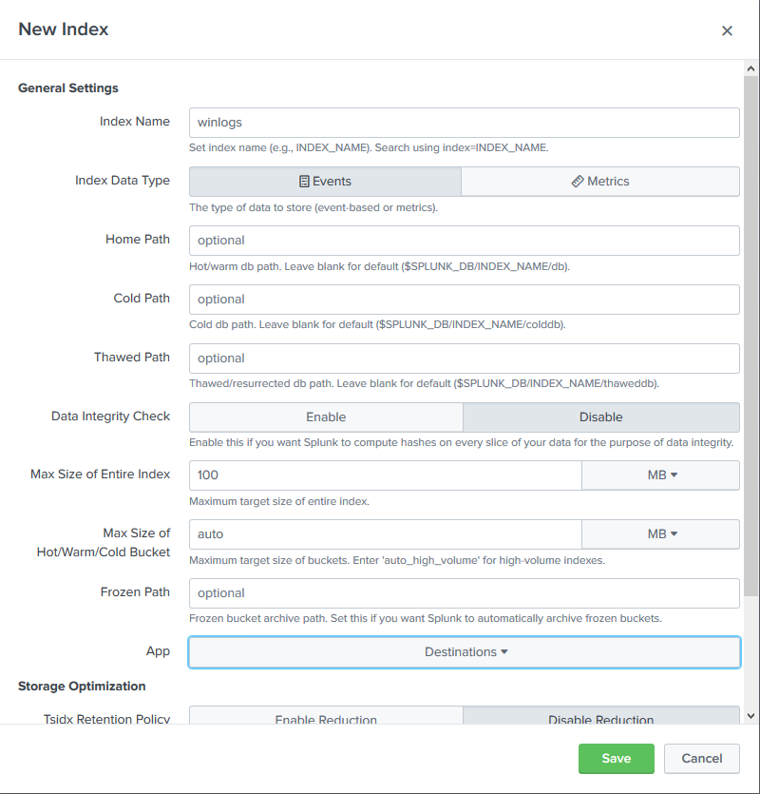
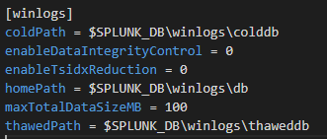
Creating Indexes
Indexes=where Splunk keeps its data
Can use default or create your own
https://docs.splunk.com/Documentation/Splunk/latest/admin/indexesconf

Slide 30
Buckets
Indexes are divided internally into age-designated directories called buckets
Hot (hotPath): Newly indexed, open for writing
Warm (warmPath): Rolled from hot, no active writing
Cold (coldPath): Rolled from warm
Frozen (frozenPath): Rolled from cold and archived
Thawed (thawedPath): Restored from archive
Default location: $SPLUNK_HOME/var/lib/splunk/defaultdb/db

Slide 31
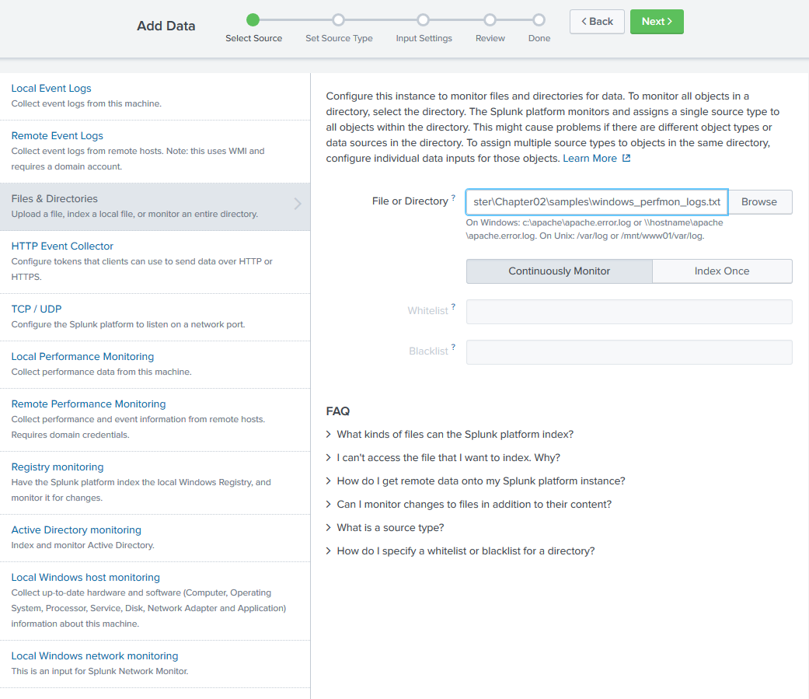
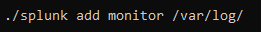
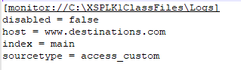
Log Files as data input
Add from:
Graphical UI
Command line
Inputs.conf
https://docs.splunk.com/Documentation/Splunk/latest/Admin/Inputsconf
Notes:
Log files are probably the most commonly defined input in Splunk, and they’re easy to configure. In fact, if you completed the labs for the first module, you’ve already configured one. The basic procedure is just to use the settings menu in the Splunk application, select “Data inputs”, click “Add New” next to the “Files and Directories” category, and follow the prompts to select the file or directory you want indexed.
Alternately, you can configure inputs directly from the command line…
…or even by editing your app’s input.conf file (though that may require you to restart Splunk)

Slide 32
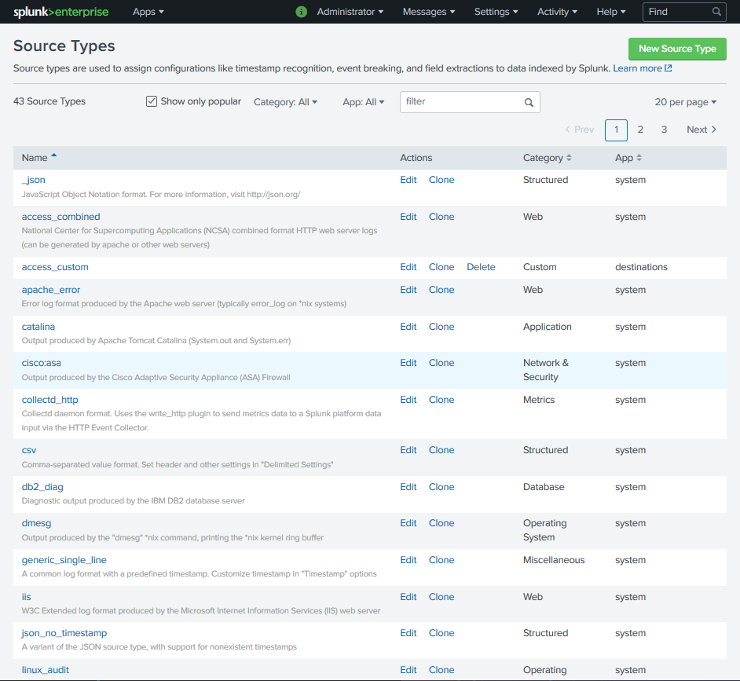
Sourcetype
Sourcetype = data classification associated with data input
Tells Splunk where important data is & how it’s formatted (e.g. timestamps)
Helps differentiate records in search results

Slide 33
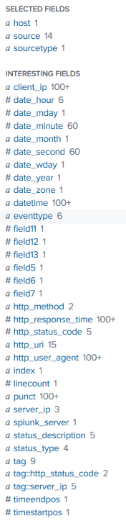
Splunk events and fields
Event = logged record of something that happened
Field = an attribute of an event

Slide 34
Default Fields
Timestamp
Host
Index
Source
Sourcetype
Linecount

Slide 35
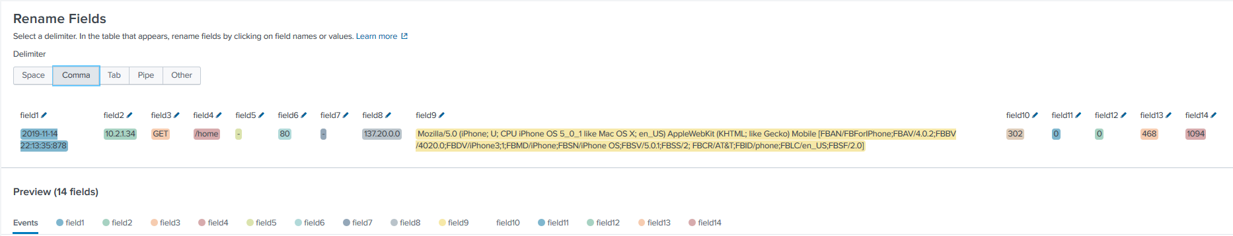
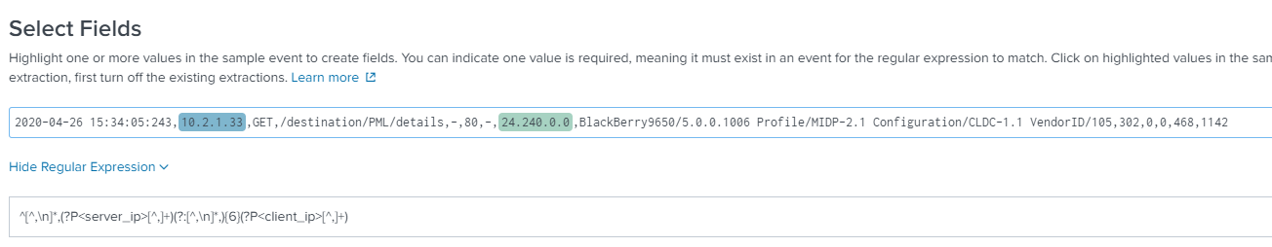
Extracting new fields
Delimited
Regular expression

Slide 36
Lab 2: Bringing In Data
Estimated Duration: 30 minutes
Creating Indexes
Pages 37-40
Log Files as Data Input
Pages 41-45
Extracting New Fields
Pages 46-51
!! NOTE: The field list in step 5 on page 49 is incorrect. See the table at the right for the correct values
field1: | datetime
field2: | server_ip
field3: | http_method
field4: | http_uri
field8: | client_ip
field9: | http_user_agent
field10: | http_status_code
field14: | http_response_time
Questions? Comments?
Dan’s cell phone: (413) 455-0856
Dan’s email: danc@onlc.com

Slide 37
Module 3: Search Processing Language

Slide 38
Search Processing Language
Anatomy of a search
Search pipeline
Time Modifiers
Filtering Searches
Search commands: stats, top/rare, chart, timechart, eval, rex

Slide 39
Anatomy of a search
SPL=Search Processing Language
Based on Unix pipeline & SQL
Extract, filter, group & summarize
Supports regular expressions

Slide 40

Search pipeline
SPL uses vertical pipe (“|”, called the “delimiting pipe”) to pass results from one phase to the next
Get raw events from internal log
Group by name field, count records in each group, keep the top 5
Sort descending (-) by name

Slide 41
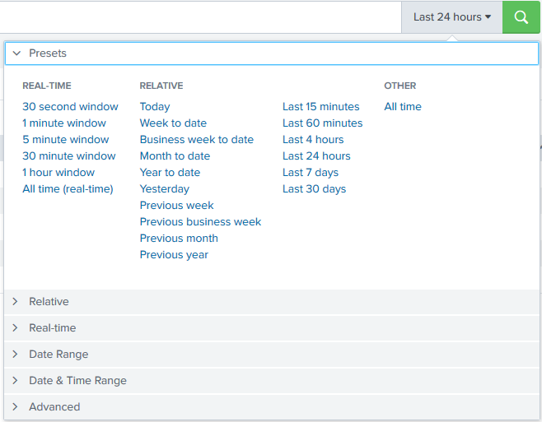
Time modifiers
Time unit | Valid unit abbreviations
second | s, sec, secs, second, seconds
minute | m, min, minute, minutes
hour | h, hr, hrs, hour, hours
day | d, day, days
week | w, week, weeks
month | mon, month, months
quarter | q, qtr, qtrs, quarter, quarters
year | y, yr, yrs, year, years

Slide 42
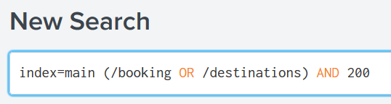
Filtering search results
Filters can be simple, e.g. http_status_code=200
…or more complicated, e.g. index=main (/booking OR /destinations) AND 200
Can use wildcards (*) and functions (e.g. regex)

Slide 43
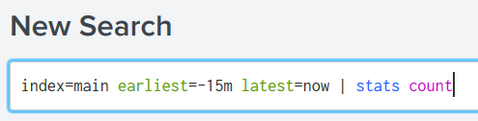
Additional Search commands: stats
Count events
count distinct_count earliest | estdc estdc_error first | latest last list | max min mode values

Slide 44
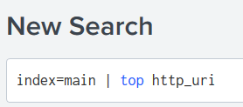
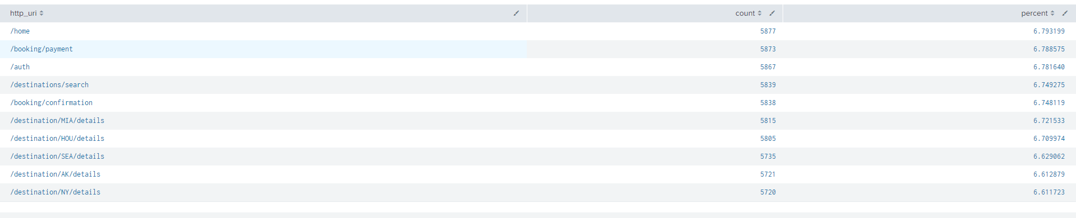
Additional Search commands: top/rare
Get a summarized table based on fields

Slide 45
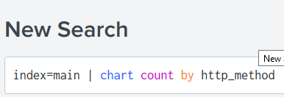
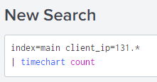
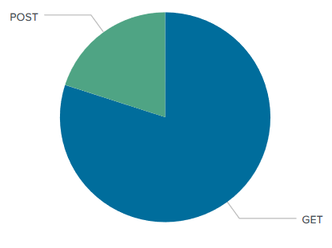
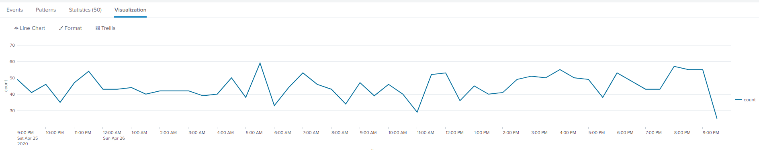
Additional Search commands: chart, timechart

Slide 46
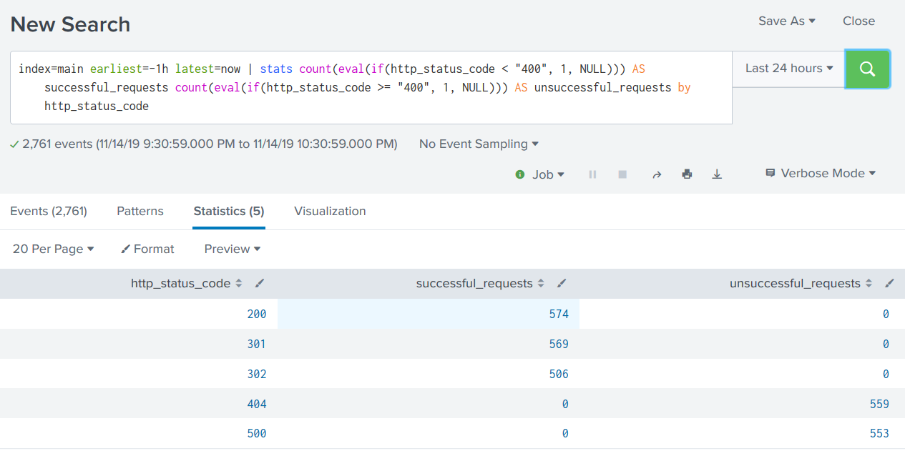
Additional Search commands: eval
Store result of evaluation in a field

Slide 47

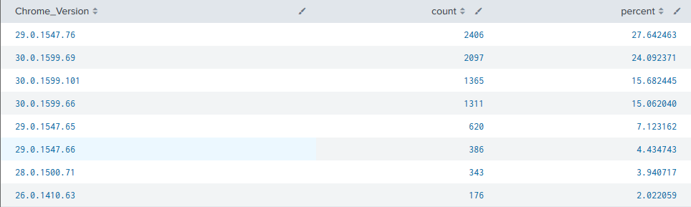
Additional Search commands: rex
Regular Expressions!!
Match patterns
Parse out substrings (runtime field extraction)

Slide 48
Lab 3: Search Processing Language
Estimated Duration: 45 minutes
Anatomy of a Search, Page 54
Search pipeline, Page 55
Time modifiers, Pages 56-57
Filtering search results, Page 58
Search command – stats, Pages 59-60
Search command – top/rare, Pages 60-61
!! NOTE: The second block of SPL in this section is incorrect. The correct SPL is:
index=main | top http_uri limit=5 showperc=false
Search commands – chart and timechart, Pages 61-64
Search command – eval, Pages 64-65
Search command – rex, Page 66
!! NOTE: The text in the book is incorrect for this command. The following is the corrected version:
index=main http_user_agent="*Chrome*" | rex field=http_user_agent "Chrome/ ?(?<Chrome_Version>.+?) ?Safari" | top Chrome_Version
Questions? Comments?
Dan’s cell phone: (413) 455-0856
Dan’s email: danc@onlc.com

Slide 49
Module 4: Reporting, Alerts, and Search Optimization

Slide 50

Reporting, Alerts, and Search Optimization
Creating event types and tags
Creating and saving reports
Getting alerts when conditions change
Making search faster

Slide 51
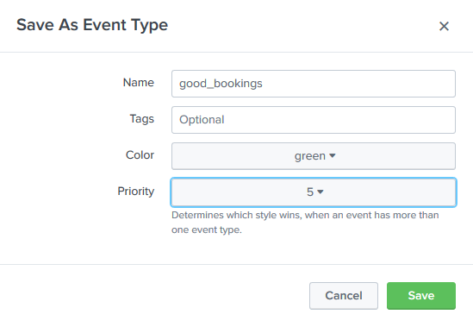
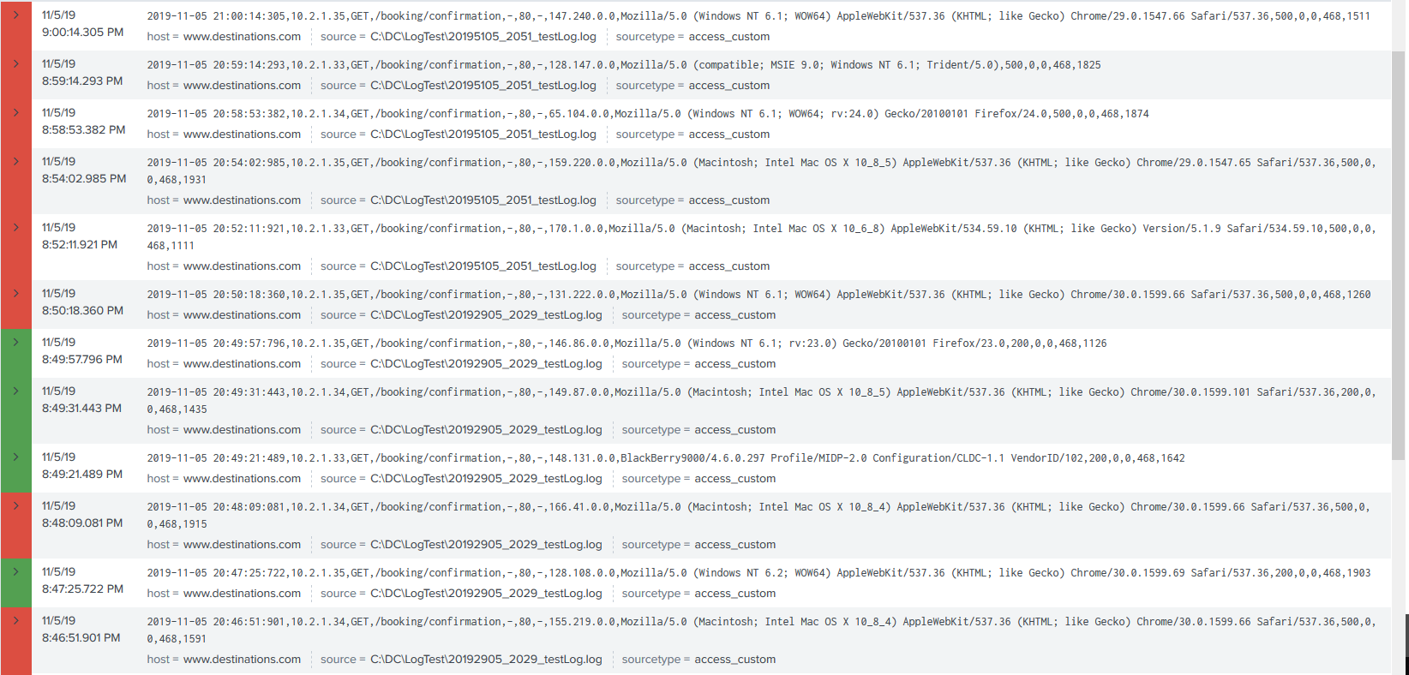
Data classification with Event Types
Event type = Label based on characteristics of the data
E.g. An event type called “Server Error” for http_status_code=50*

Slide 52
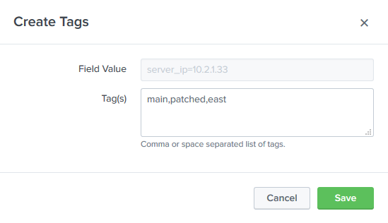
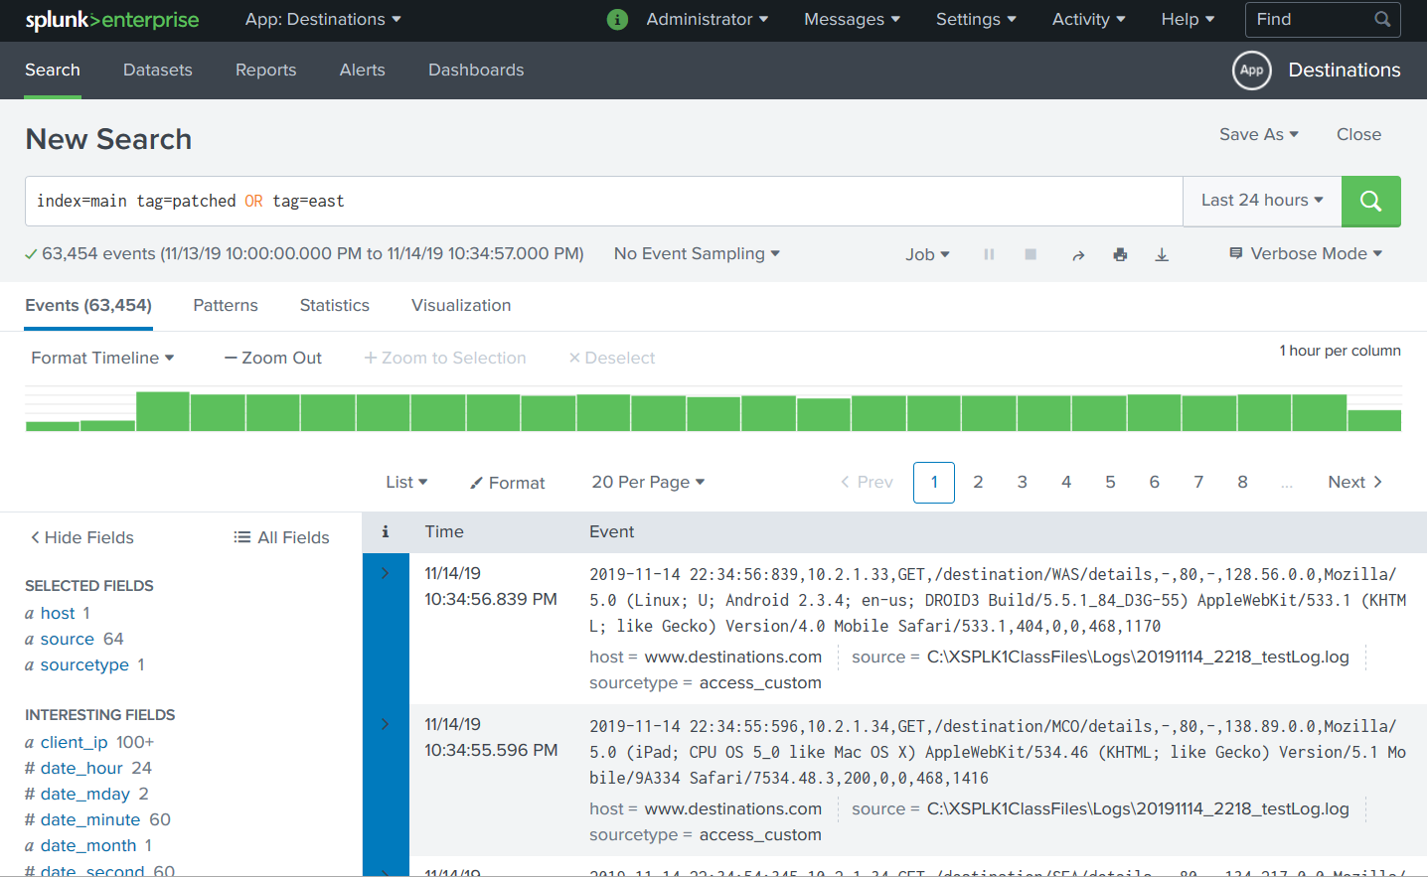
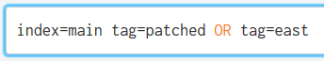
Data normalization with Tags
Allow you to further categorize your data

Slide 53
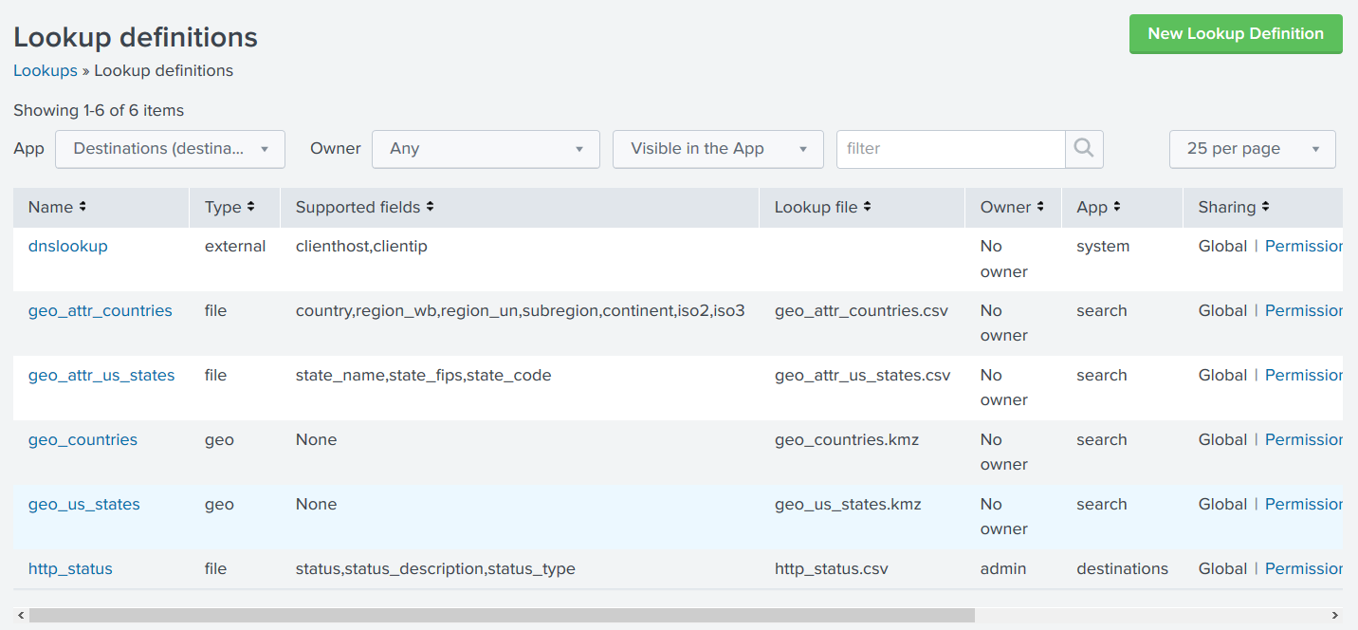
Data enrichment with Lookups
E.g. convert codes to recognizable labels

Slide 54
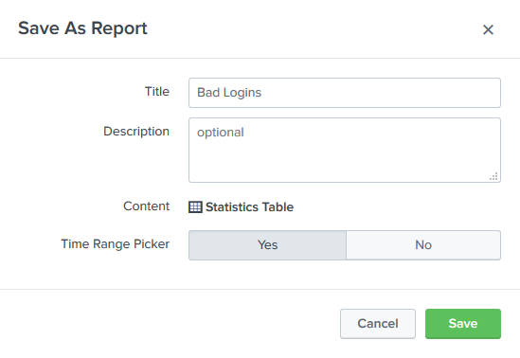
Creating and scheduling reports
Report=stored searches and visualizations of the results
Can be run ad-hoc or on a schedule

Slide 55
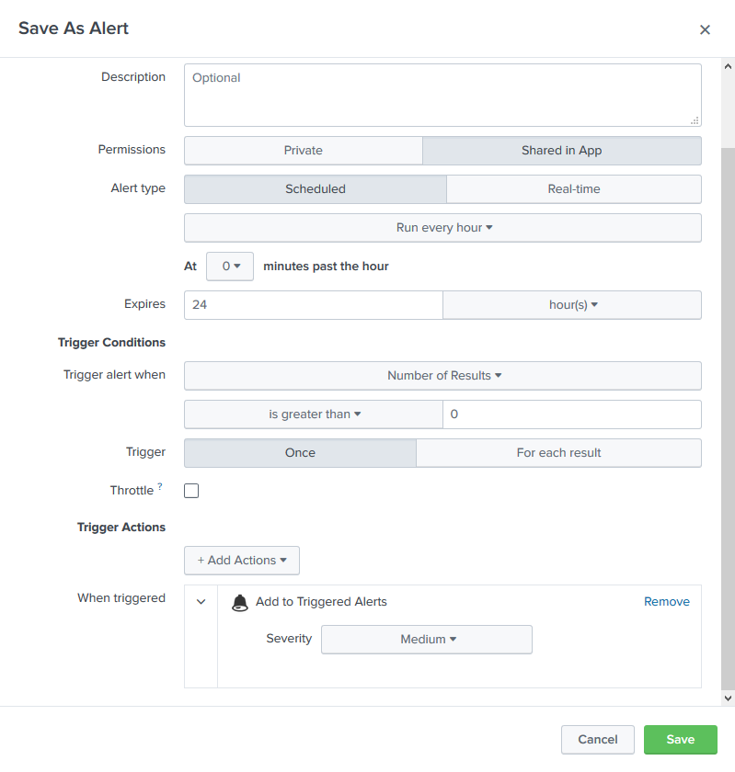
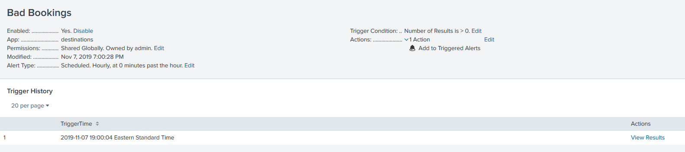
Creating alerts
Allow automatic notification of specific conditions or events

Slide 56
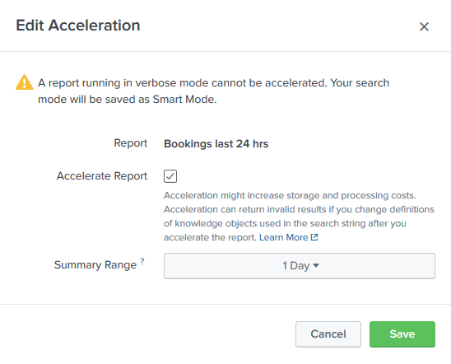
Search and Report acceleration
Parts of reports can be pre-summarized to allow faster retrieval later

Slide 57
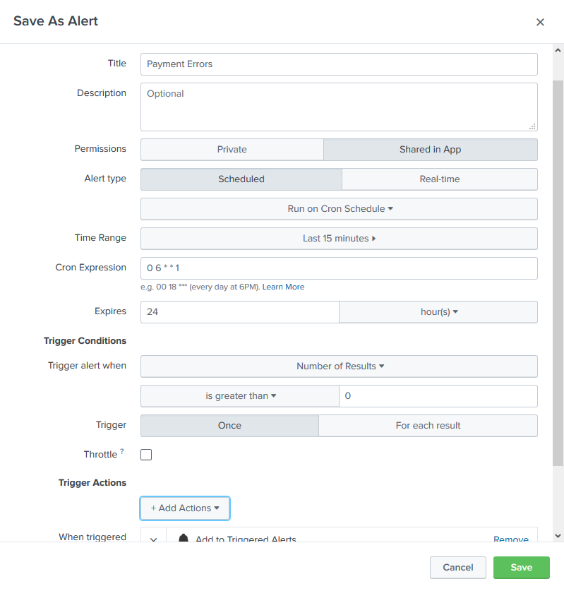
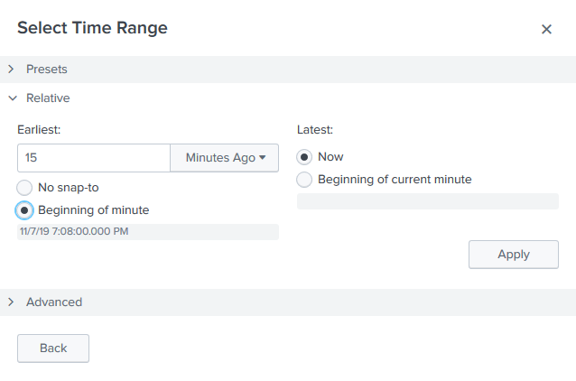
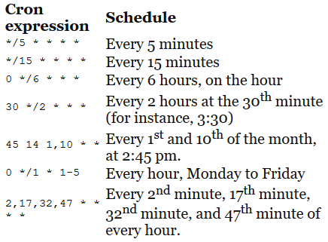
Scheduling options
Schedules should be staggered to avoid performance issues
Time windows
Custom Cron schedules

Slide 58
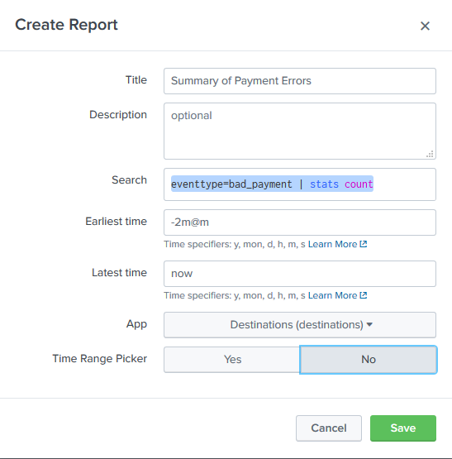
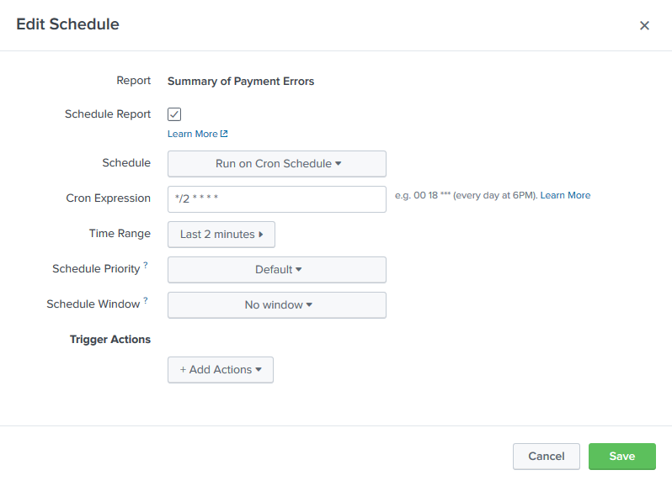
Summary indexing
Create a smaller, summarized index for statistics

Slide 59
Lab 4: Reporting, Alerts, and Search Optimization
Estimated Duration: 45 min
Data classification with Event Types, Pages 70-73
Data normalization with Tags, Pages 74-76
!! NOTE: On page 76, the table of field value pairs and tags shows spaces between the field name, equals signs, and values. This is not right and will cause the lab to fail. See notes for the correct version of the table.
Data enrichment with Lookups, Pages 77-82
Creating and scheduling reports, Pages 82-86
!! NOTE: The last section on page 86 refers to Datasets and Pivots which have not yet been created (they will be created in Chapter 6). This is presumably due to the authors restructuring the book at some point. Therefore, skip the last part of the exercise (bottom half of page 86) as it requires Datasets that don't exist yet.
Creating alerts, Pages 87-90
!! NOTE: Most of pages 89 & 90 consist of explanations rather than instructions. For the sake of the lab, it is safe to skip these sections (though they are informative and worth a read at some point).
Search and Report acceleration, Pages 91-92
Scheduling options, Pages 92-94
Summary indexing , Pages 95-98
Questions? Comments?
Dan’s cell phone: (413) 455-0856
Dan’s email: danc@onlc.com

Slide 60
Module 5: Dynamic Dashboarding

Slide 61

Dynamic Dashboarding
Creating effective dashboards
Types of dashboards
Dashboard layouts

Slide 62
Creating effective dashboards
Single screen view
Multiple data points
Focus on critical information
User-oriented
Loads quickly
Minimize redundancy

Slide 63
Types of dashboards
Dynamic form-based
Real-time
Scheduled reports

Slide 64

Types of dashboards
Dynamic form-based
Real-time
Scheduled reports

Slide 65

Dynamic Form-Based Dashboard

Slide 66


Dynamic Form-Based Dashboard

Slide 67


Dashboard Layouts

Slide 68




Panel Options

Slide 69


Form inputs
Label: Control’s label in UI
Search on Change: Triggers search when value changes
Token: (=“variable”) Value passed to search from control
Default: Control’s default value
Others vary with control

Slide 70


Creating a time range input
Create shared time picker control
Reference shared time picker from panels

Slide 71

Static real-time dashboard

Slide 72


Creating a choropleth map

Slide 73
Lab 5: Dynamic Dashboarding
Estimated Duration: 60 minutes
Dynamic form-based dashboard, Pages 104-105
Creating a Status Distribution panel, Page 106
Creating the Status Types Over Time panel, Page 107
Creating the Hits vs Response Time panel, Page 108
Arrange the dashboard, Pages 108-109
Panel options, Pages 109-111
Pie chart – Status Distribution, Page 111
Stacked area chart – Status Types Over Time, Pages 112-113
Column with overlay combination chart – Hits vs Response Time, Pages 114-115
Form inputs, Pages 115-118
Creating a time range input, Pages 118-120
Creating a radio input, Pages 121-126
!! NOTE: In step 6, the instruction to type "server:" is wrong -- it should not have the colon (:) at the end. It should read:
6. In the Token field, type server
Creating a drop-down input, Pages 126-129
Static real-time dashboard
Single-value panels with color ranges, Pages 130-133
Creating panels by cloning, Pages 135-135
Single-value panels with trends, Pages 135-137
Real-time column charts with line overlays, Pages 137-140
Creating a choropleth map, Pages 140-142
Questions? Comments?
Dan’s cell phone: (413) 455-0856
Dan’s email: danc@onlc.com

Slide 74
Data Models and Pivots

Slide 75
Data Models and Pivots
Create a data model
Enable acceleration for the data model
Create a Pivot output
Visualize data

Slide 76
Data Models and Pivots
Ad hoc, visual analysis (no SPL necessary!)
Data Model: Hierarchical mapping of data based on search results
Pivot tool: summarize data fields in rows & columns
Create crosstab reports

Slide 77



Creating a data model

Slide 78


Adding attributes to objects

Slide 79


Creating child objects

Slide 80


Creating an attribute based on a regular expression

Slide 81



Data model acceleration

Slide 82

Creating a dashboard

Slide 83

Rearranging your dashboard

Slide 84
Lab 6: Data Models and Pivot
Estimated Duration: 45 minutes
Creating a data model, Pages 146-147
Adding attributes to objects, Pages 148-149
Creating child objects, Pages 149-150
Creating an attribute based on a regular expression, Pages 150-153
Data model acceleration, Pages 153-155
The Pivot editor, Pages 155-158
Creating a Pivot and a chart, Pages 158-160
Creating an area chart, Pages 160-163
Creating a pie chart, Pages 163-166
Single value with trending sparkline, Pages 166-168
Rearranging your dashboard , Page 168
Questions? Comments?
Dan’s cell phone: (413) 455-0856
Dan’s email: danc@onlc.com

Slide 85
Thank you!
Questions?
Survey: http://www.onlc.com/eval

